Slide 1
Steadiness
selfcareproject.com.au

Slide 2
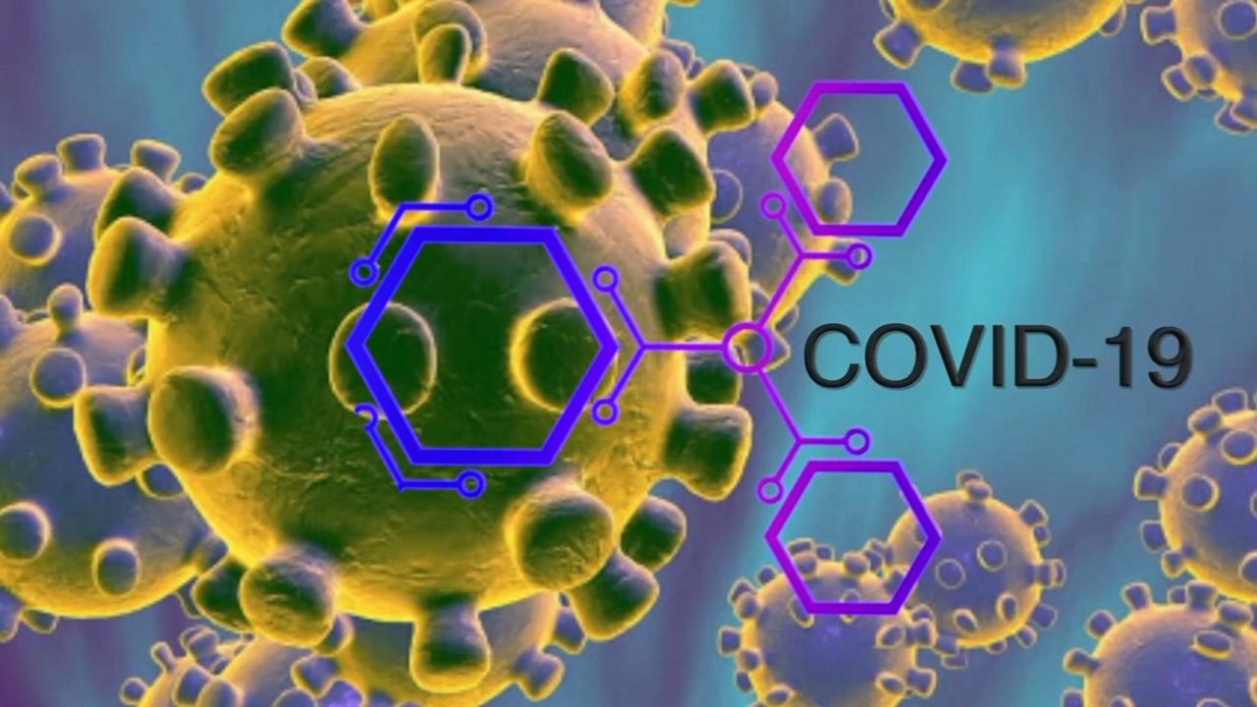
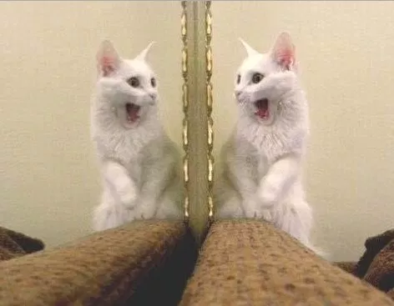
selfcareproject.com.au
Notes:
What’s your experience of COVID-19 been?
There’s a whole range of experience you may have been having. It can be somewhat of a roller coaster, changing week to week, day to day, hour to hour.

Slide 3
What we will cover
Outline ways that contribute to steadiness, that directly aim to ease the nervous system
There’s lots of different ways,
We are all different
Find the bits and pieces that work for you
Approach and adapt things in a way that works for you, when it is useful
selfcareproject.com.au

Slide 4
selfcareproject.com.au
Notes:
Skill of reading the landscape and mapping. We use it all the time e.g. when you drive a car you read the traffic and make judgements based on your ‘map’ of what is happening.
There’s two parts – noticing what is happening
- your understanding of what’s happening
Really important in self care if we can pick up what’s happening in the internal landscape

Slide 5
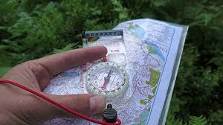
Reading the map
How well you can tell what’s going on. Internal state
Physical, mental, behavioural, emotional,
What are some words that describe what we’re seeing? Uncertain, tense, wound up, less tolerant, anxious, afraid, protective, reactive, alone, roller coaster, overwhelmed, too much.
Hopeful, calm, challenge, learning, together, support
selfcareproject.com.au
Notes:
Sometimes we just get a sense of something and we can sometimes struggle to try to find words that to describe that sense. Experiences aren’t always located and linked to the part of our brain where words are held. People often use metaphor or other ways to describe e.g. colour, shape, weight (heavy, light)

Slide 6
Step back, and pause. notice what’s going on and how much it’s there.
selfcareproject.com.au
Notes:
A really important skill at the moment.
So much has happened and so much change has occurred in such a short time.
We need to have some space to reflect and process this. Some breathing space.
Ok, lets give this a quick go. Ok, so what I want you to do is to monitor your internal reactions.
So what happens when you see this ….(next slide)

Slide 7
selfcareproject.com.au
Notes:
Imagine it’s there in front of you, what’s your response. Do you move towards it or move away. Key thing to notice inside yourself. Does it make you feel good, or not. Do you feel safe or unsafe.
So you can probably guess where the next picture might go.

Slide 8
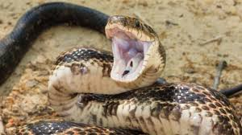
selfcareproject.com.au
Notes:
What if this was in front of you and you knew it was poisoness. Would you want to move towards or away? Would you want to pat it? Would your adrenaline be running? Would you want to attack or want to run – and obviously it would depend on how close it would be to you. Or would you be peaceful and completely non reactive. story

Slide 9
selfcareproject.com.au
Notes:
So what about this one? Your ability to read what’s happening and your responses to what you’re noticing are the key.
If you are a supporter it might depend on who’s side you are on.

Slide 10
Benefits of reading the map
It gives you information, it tells you what’s going on
It tells you if what you’re doing is working
Stepping back and being aware creates separation and distance from what’s happening
It changes the brain, it steadies the brain – The well researched benefits of mindfulness.
selfcareproject.com.au
Notes:
See the workbook for more details
Observing gives space between you and what you’re observing. In that space you have, even if it is just the smallest bit, influence over your response. But even if you don’t, just the space is useful.

Slide 11
Steadying the ship
selfcareproject.com.au

Slide 12
selfcareproject.com.au
Notes:
When you are in this space it builds capacity rather than expending capacity.
What word isn’t in this? relax. Dentist story – when I was a child the dentist approached with a big needle and said ‘just relax’. This did not make sense to my nervous system.
Sometimes it doesn’t make sense to the nervous system that it should relax when there is so much upheaval and things appear dangerous and threatening, or we are being hurt by what has happened. Steadiness can be there and help us relax or calm when relevant, but equally be something we hold on to when we mobilize ourselves, or be there when we are hurting.
Sometimes it’s not right for steadiness to be on our radar as we are just hurting and even thinking we should be steady is not what we need. Being responsive to our needs, compassionate towards ourselves, going through things as we need to and as we are, and as best we can, rather than as we would like things to be, or us to be - is what our task is.

Slide 13
Stabilizing, steadying
When we talk about steadiness/stabilizing /regulation we are really talking about the state of our nervous system.
The nervous system is like the keel of a yacht
selfcareproject.com.au
Notes:
Regulation skills, skills in maintaining and regaining balance.
Don’t have conscious control over our steadiness, but can influence – sometimes more than others. And that’s where the skills come in.

Slide 14
Skills
It is normal to go in and out of steadiness. When disruption occurs it can throw us significantly. It’s just how our nervous system is designed.
selfcareproject.com.au
Notes:
It is not wrong or bad to be out of balance. It is alright and part of being human. It is not a judgement of how we are as a person, or what you can contribute. You might prefer something different,
Sometimes we can be ok with being out of balance, sometimes we can’t. The ‘ok with it’ place has greater steadiness, but remember it is ok not to be steady.

Slide 15
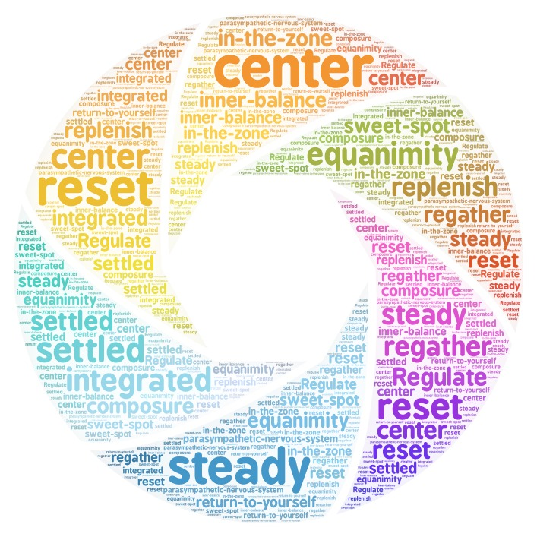
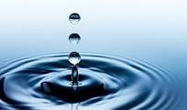
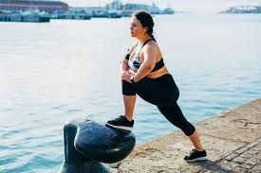
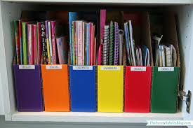
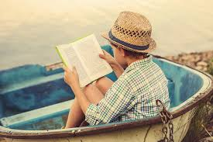
Ideas
Calm – settle, grounding, orientating, mindfulness
Release – get it out
Contain – structure
Tune out – things that distract and take your mind away from things.
selfcareproject.com.au
Notes:
– remember more than relaxing, you want to see if you can put in some steadiness. And then if it’s safe and ok you might want to relax. Equally an element of steadiness is also good if you are in a situation where the adrenaline is pumping, your heart is racing. When things are going off inside of you, you’re caught up in your reaction, or hurting.
there’s 4 general approaches -
Calm – breathing. Focus on the out breath, meditation, orientating – Steve Smith the cricketer pointing to the fielders.
Release - You know when people talk about decompressing, or letting off steam, is that concept of getting it out, releasing it. Lots of different ways to do this e.g. Exercise is a great one especially because it helps to burn off the stress and process the chemicals – doesn’t have to be intense, just any sort of movement even just wriggling or scrunching up your toes, often that sense of movement and action is good and helpful psychologically. Other people talk, someone I knew would clean the house
Action. exercise, do things, talk, things that provide a sense of control to your nervous system, (growling!)
Contain – compartmentalize, what do I have to do now, things that are specific, writing things down - example, things that have structure and achievement. A deliberate use of a ‘map’, a deliberate strategy
Tune out – doing something different, getting some psychological distance/a break. Gives relief, even if just a bit which is good for psychological flexibility. Utilizes a different part of your brain. Allows capacity to come on board. Not too much, not too little approach. The ‘hokey pokey’ approach. Dipping in and out
Activity – identify where you’ve used each of these, even if just a bit. come up with some ideas about what each could be.
Activity – breathing exercise, mindfulness exercise – choice of things
Maps can help this - It’s ok as I know where I am on the map. Story – Kim - Map about grief and loss.
Exercise – what’s a map that has helped you stay steady? What’s a map that takes you away from home base. When I come from this place I lose my steadiness. Not about right or wrong.

Slide 16
Tips for putting things into action
Try something out, see what happens
Spend a specific time trying/practicing it – for an hour, day, week, etc.
Don’t put too much effort into calming down
Think steps and as a transition
Practice before hand and your ‘training’ is more likely to kick in. Don’t try too hard.
selfcareproject.com.au

Slide 17
Spaces to pause, be still, and process
Notes:
At this time many people benefit from spaces to pause, be still and reflect. So much change has happened in such a short time. There’s an incredible amount of information and activity. COVID – 19 is often at the forefront of our awareness and the awareness of people around us.
We need places where we can stop (or at least slow a bit), pause, take a breath, be still, and process. Reflective places. We may not actively think about things, but if we do it’s more reflective than active.
It gives a chance for things to process through, often beneath the surface of our consciousness. It gives space for things to emerge. The process of giving space to allow things emerging is different from actively thinking about things.
We may sit and have a cup of tea or coffee, go for a walk, meditate or pray, do something that opens up that place for us. Someone I know did jigsaw puzzles (but that would frustrate me!). Look for things that give you that sense. You may also be able to bring a bit of that sense into the way you do other things.
Go well and take care

